Slide 1




Machine learning for probabilistic catalogs: an example of Fermi LAT point sources
Dmitry Malyshev
with Aakash Bhat
Gamma group meeting
June 25, 2020 ECAP

Slide 2
Plan
Motivation
Unassociated sources
Missing sources
Construction of a probabilistic catalog from the Fermi LAT 3FGL catalog
Comparison of unassociated sources in 3FGL with sources in 4FGL

Slide 3
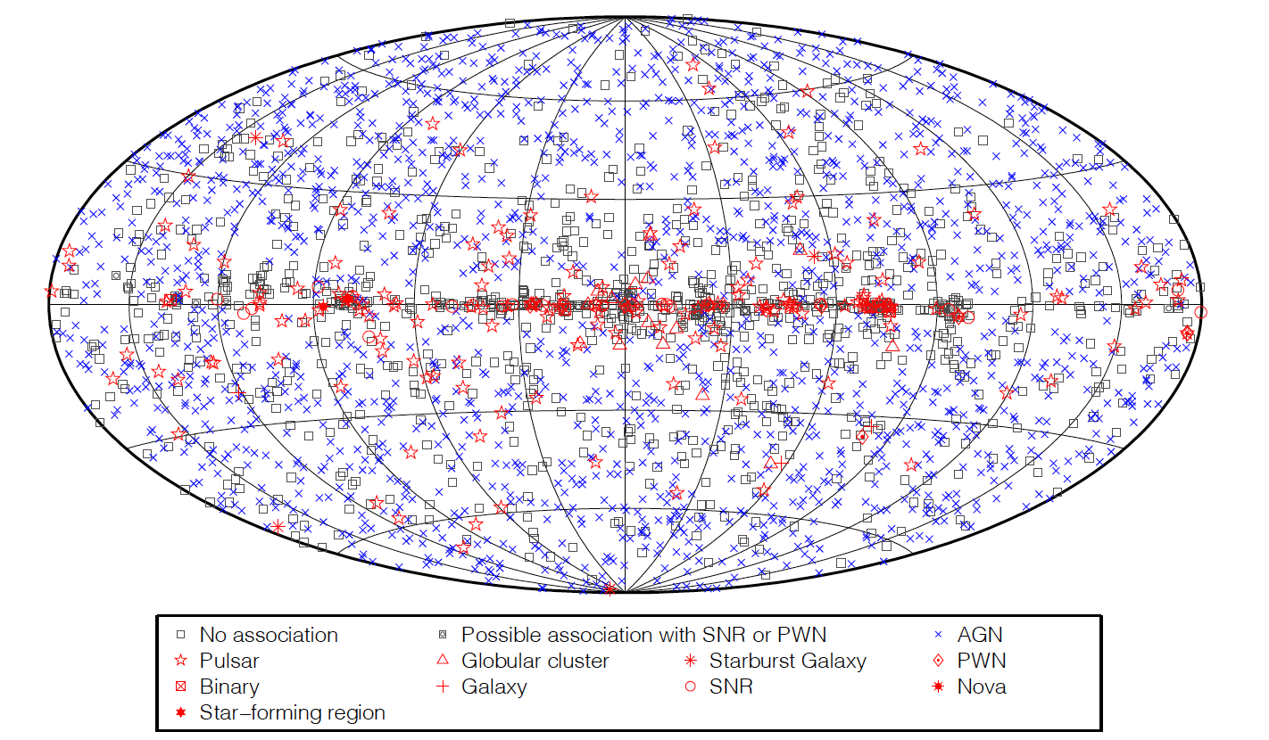
Motivation I
Unassociated sources
Typically about 1/3 of sources in the Fermi LAT catalogs do not have associations with known sources
out of 3033 3FGL sources 1010 are unassociated
Acero et al. (2015)

Slide 4
Motivation I
Unassociated sources are not “useless”
For example, some of the sources are more likely to be pulsars (PSRs) based on their 3FGL properties
Spectra
Position
Absence of variability
These sources can be used for the searches of pulsars with radio telescopes, which have small ROIs, i.e., it’s good to know where to search.

Slide 5
Motivation II
Fermi LAT 4 year catalog 3FGL has 3033 sources
How many of these sources have disappeared in the 8 year catalog 4FGL?
100, 200, 500, 1000?
Almost 500: 469 sources are missing (about 15%)
300/1873 (16%) 2FGL sources are not in 3FGL
310/1451 (21%) 1FGL sources are not in 3FGL
Can these sources be missing due to statistical fluctuations?

Slide 6
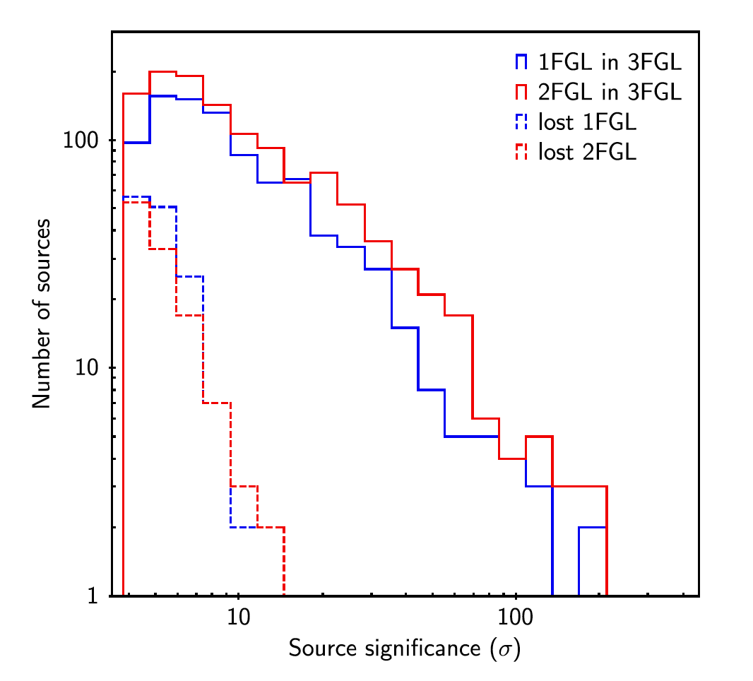
Motivation II
Significance of 1FGL and 2FGL sources missing in 3FGL
If the spurious sources were due to random fluctuations, then at 5 sigma there would be ~ 100 fewer sources than at 4 sigma
Thus the majority of sources, at least above 5 sigma, are/were real, but for some reason are not included in 3FGL
Acero et al. (2015)

Slide 7
Reasons for missing sources
1FGL and 2FGL sources can be missing in 3FGL because of:
Variability: a source is active during 1 or 2 years, but then becomes faint, so that the significance in 3FGL is less than the threshold
A source is split into two sources
A source / sources become a part of an extended source
Sources were due to mismodeling of the diffuse background: get absorbed in the diffuse emission in the new catalog
Random fluctuations
Acero et al. (2015)

Slide 8
What can we do?
One could cut at higher significance
Then we exclude some of the spurious sources, but we also exclude a lot of real sources
Besides, “spurious” sources may very well be real, we just assign them wrongly
One could also cut at lower significance, then some of the variable sources will be recovered
But then we pick up more random fluctuations and likely also more variable sources that later disappear
Acero et al. (2015)

Slide 9
Clean vs complete samples
The problem of the choice of the threshold can be expressed in terms of the clean vs complete catalogs
Clean – high threshold – we allow as few spurious sources as it is possible
But lose many real sources
Good for finding average properties in a class, e.g., cutoff energy of pulsars
Complete – low threshold – include as many sources as possible
But also include many spurious sources
Good for finding anomalies, strange sources, new physics – we don’t want to miss anything albeit at the expense of more noisy data
Acero et al. (2015)

Slide 10
Clean and complete samples?
The problem is that in standard catalogs one has to choose a hard threshold, i.e., 4σ or 5σ.
The idea of probabilistic catalogs is to replace the hard threshold by a soft one, e.g., probability
Then the user can select a threshold for his or her needs:
High probability threshold for a clean sample
Low probability threshold for a complete sample
Acero et al. (2015)

Slide 11
Probabilistic catalogs and machine learning
How do we find the probabilities for associations of sources?
For example, how do we estimate the probability that a particular unassociated source is a pulsar or an AGN?
Machine learning (ML) is a natural framework for this task:
We start with a list of sources with known classifications and “train” ML algorithms to estimate the probabilities of classes given the characteristics of sources, such as spectral index, position on the sky, total flux, variability etc.
Many ML algorithms can take source features as input and output probabilities of classes. We will use
Random Forests (RF)
Boosted Decision Trees (BDT)
Logistic Regression (LR)
Neural Networks (NN)

Slide 12
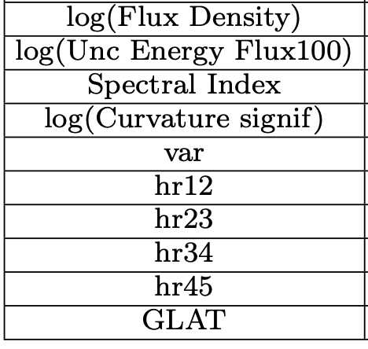
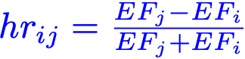
Training of algorithms: general steps
We will consider a two-class classification problem and use active galactic nuclei (AGNs) and pulsars (PSRs) from Fermi LAT 3FGL catalog as the data
Analysis steps
Select input features
We will use 10 features
Select training and test samples
We will use associated AGNs and PSRs (1905 sources out of 3033 in 3FGL) and split them in 70% and 30% for training / testing respectively
Optimize meta-parameters: number of trees and depth of trees for RF and BDT, number of hidden layers and neurons in NN
For each set of meta-parameters, we determine the classification and test it on the testing sample

Slide 13
RF: optimization of meta-parameters
As an example, we will consider optimization of meta-parameters for the RF algorithm
Parameters:
Number of trees
Maximal depth of a tree
The testing score is obtained by taking 100 realizations of 70/30 % splits and calculating the average performance on the 30% testing samples

Slide 14
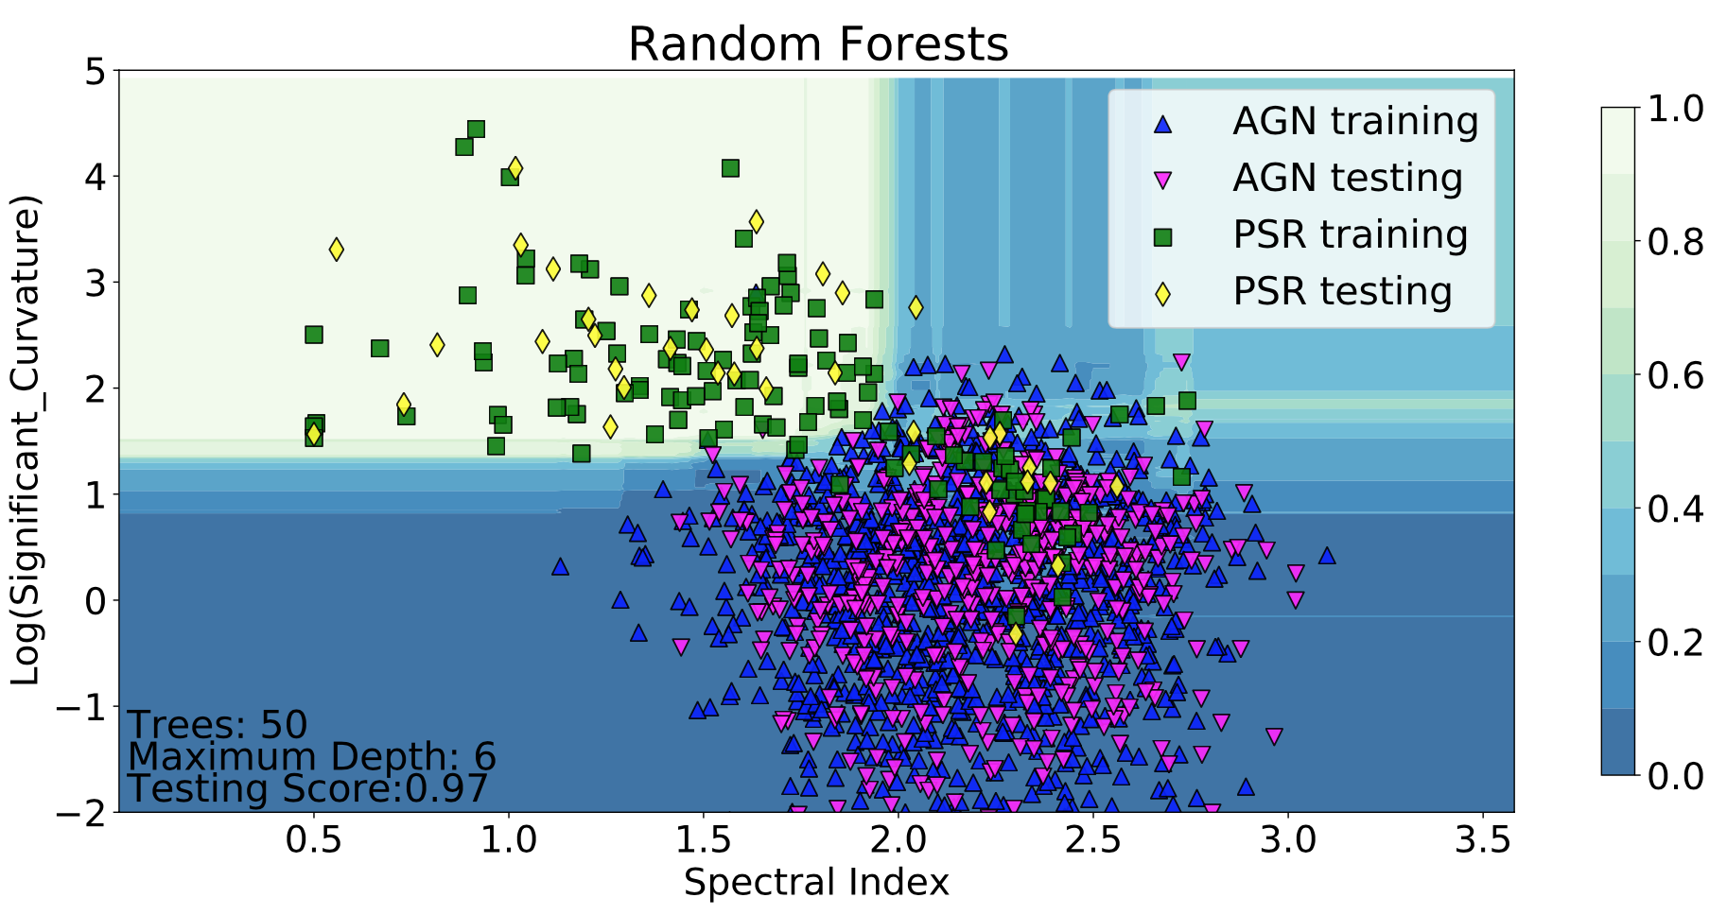
Visualization of classification
The classification of sources into AGNs and PSRs can be visualized with probability domains
In this example (for visualization purposes) we use only two features: log of curvature significance and spectral index instead of the 10 features

Slide 15
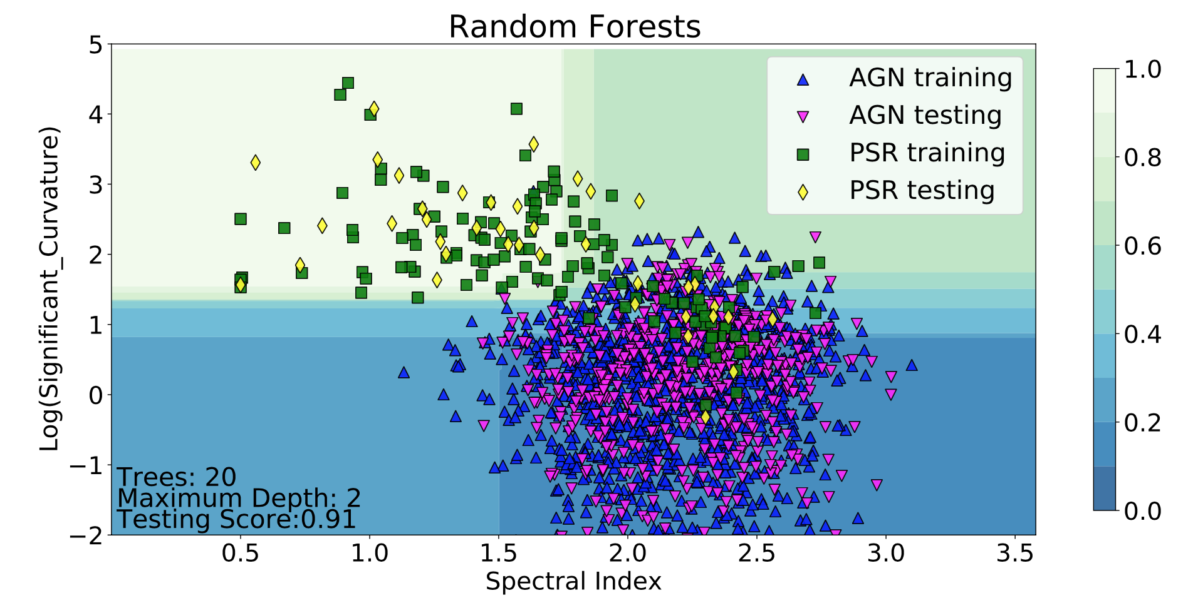
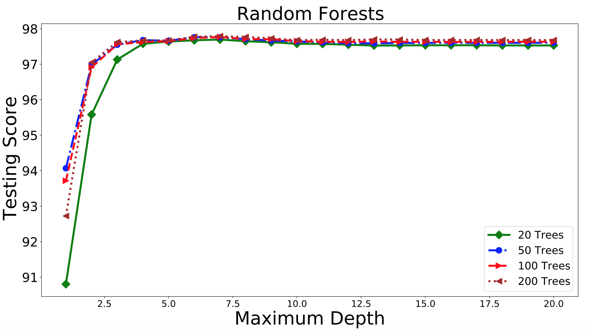
RF domains with fewer parameters
In the previous slide, it looks like the RF algorithm is overfitting the data. This is in part due to the fact that we use only two features instead of 10.
If we reduce the number of trees and the depth, then the domains look smoother. This is however no real overfitting, as one can see on the plot on the right.

Slide 16
Meta-parameters for BDTs
In case of Boosted Decision Trees, increasing the depth of the trees in fact leads to overfitting the data
The best performance is obtained for max depth of 2 with about 100 trees

Slide 17
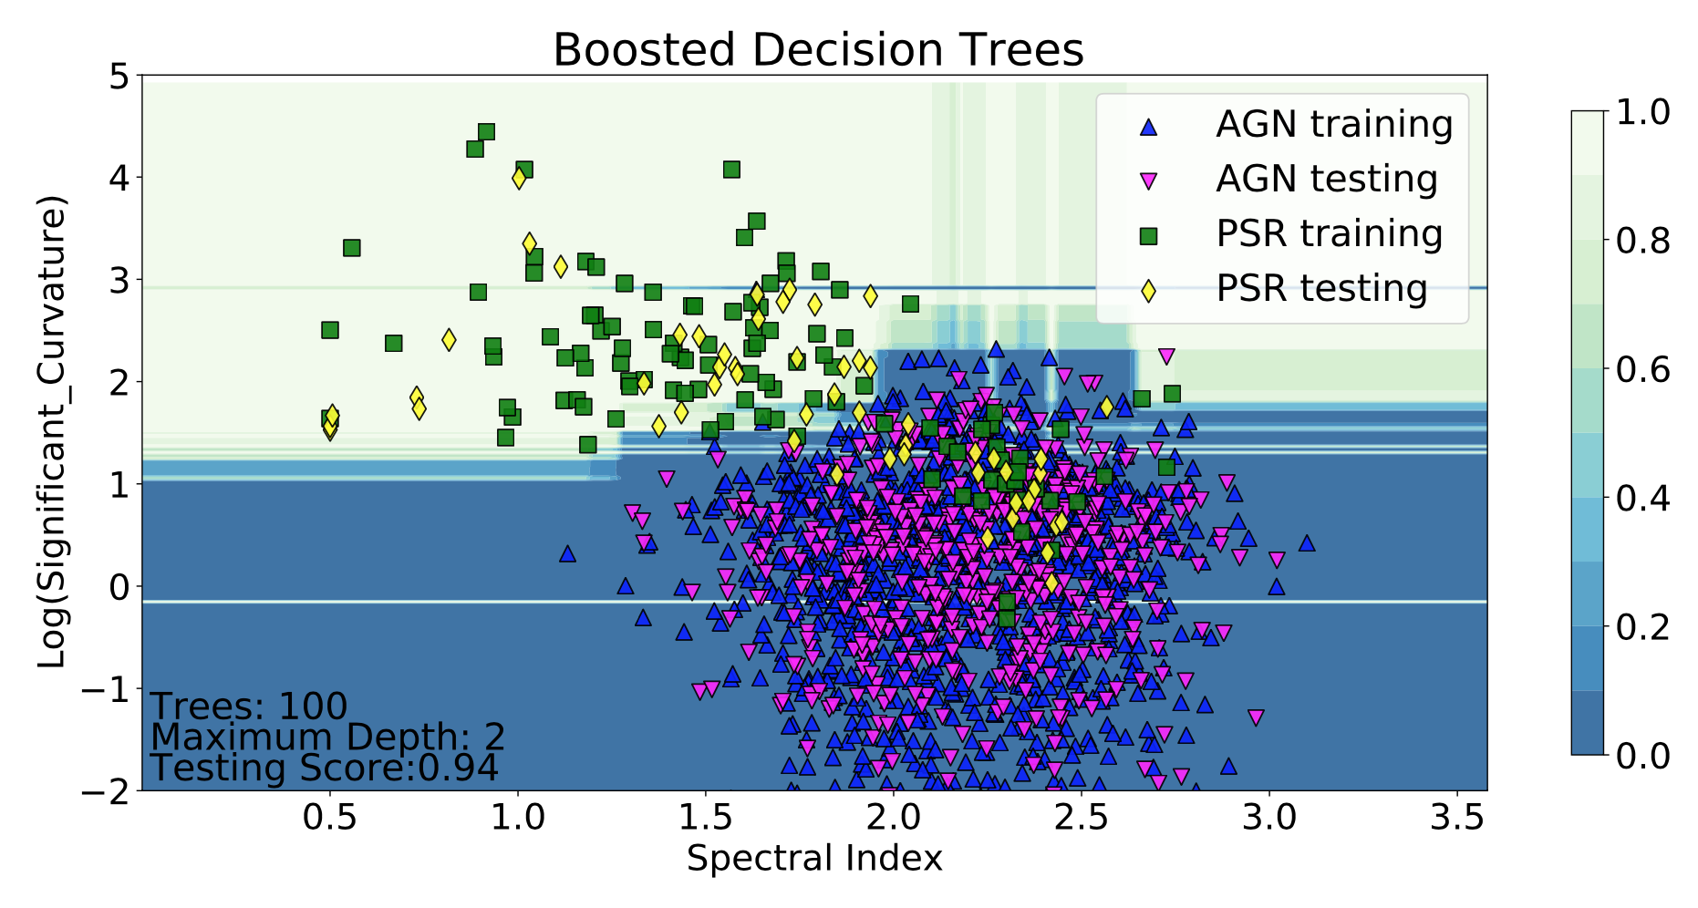
Domains for BDTs
For the BDTs, there are signs of overfitting (very narrow bands in the domains), which were not there for the RF. Nevertheless, the overall performance on testing data is similar to RF.

Slide 18
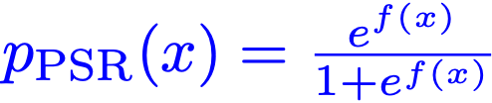
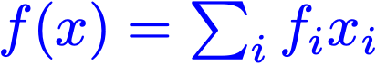
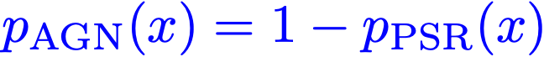
Logistic regression
For the logistic regression, the probability of a class, e.g., PSR, can be explicitly written as
where f(x) is a linear combination of input features x_{i} with unknown coefficients f_{i}
The probability of the AGN class is then
The unknown coefficients f_{i} are obtained by maximizing the likelihood that the training data is generated from the above probabilities.

Slide 19
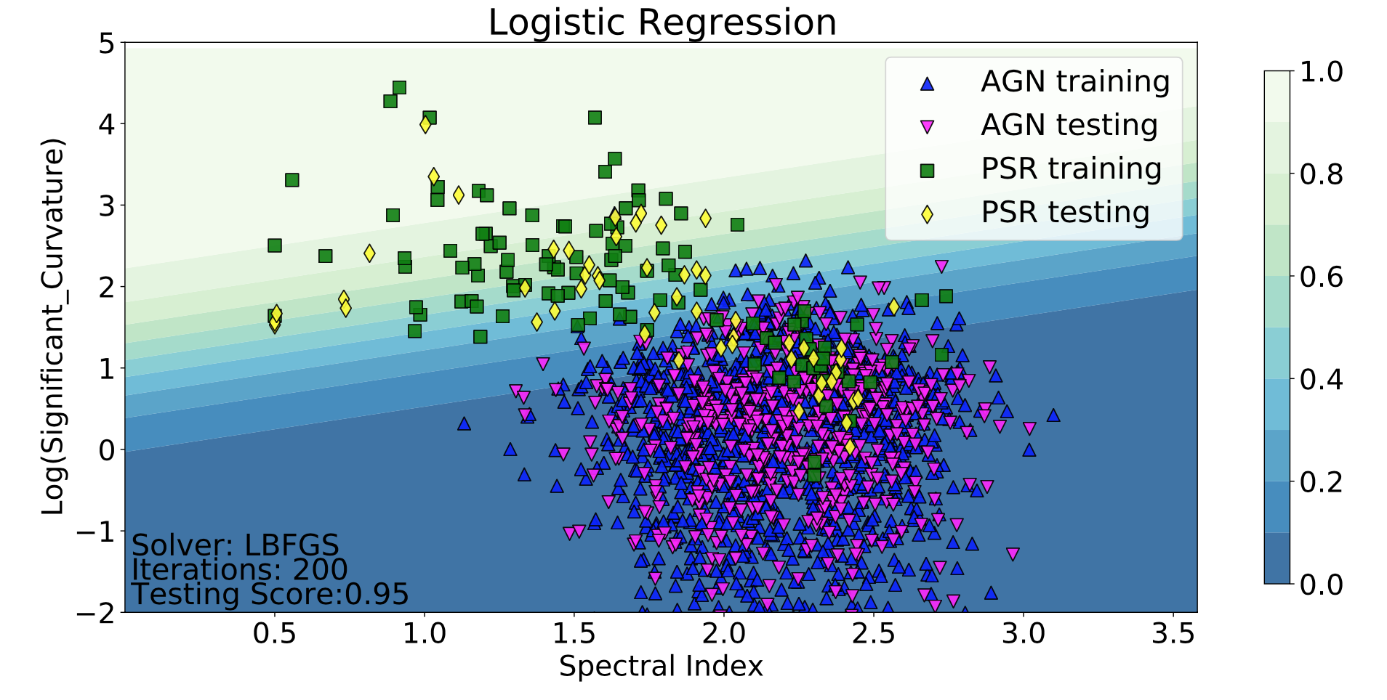
Domains for LR
The domain boundary for the LR in case of linear function f(x) is linear (hyperplane):
In general, f(x) can be a non-linear function of input features x. In this case, more complicated boundaries are possible.
We see that already linear f(x) gives good classification accuracy.

Slide 20
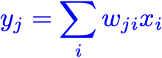
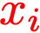
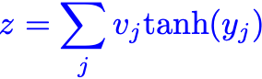
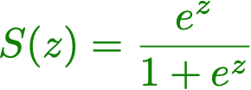
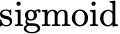
Neural networks
For the neural network we use two hidden layers with N nodes in the first layer and 1 node in the second layer.
The activation function for the second hidden layer is the sigmoid function (the same as in the definition of LR)
Output
Input
Hidden

Slide 21
NN meta-parameters
We tried different solvers, activation functions after the first hidden layer, and the number of neurons in the first hidden layer.
Our final choice is: ADAM, tanh, and 10 neurons.

Slide 22
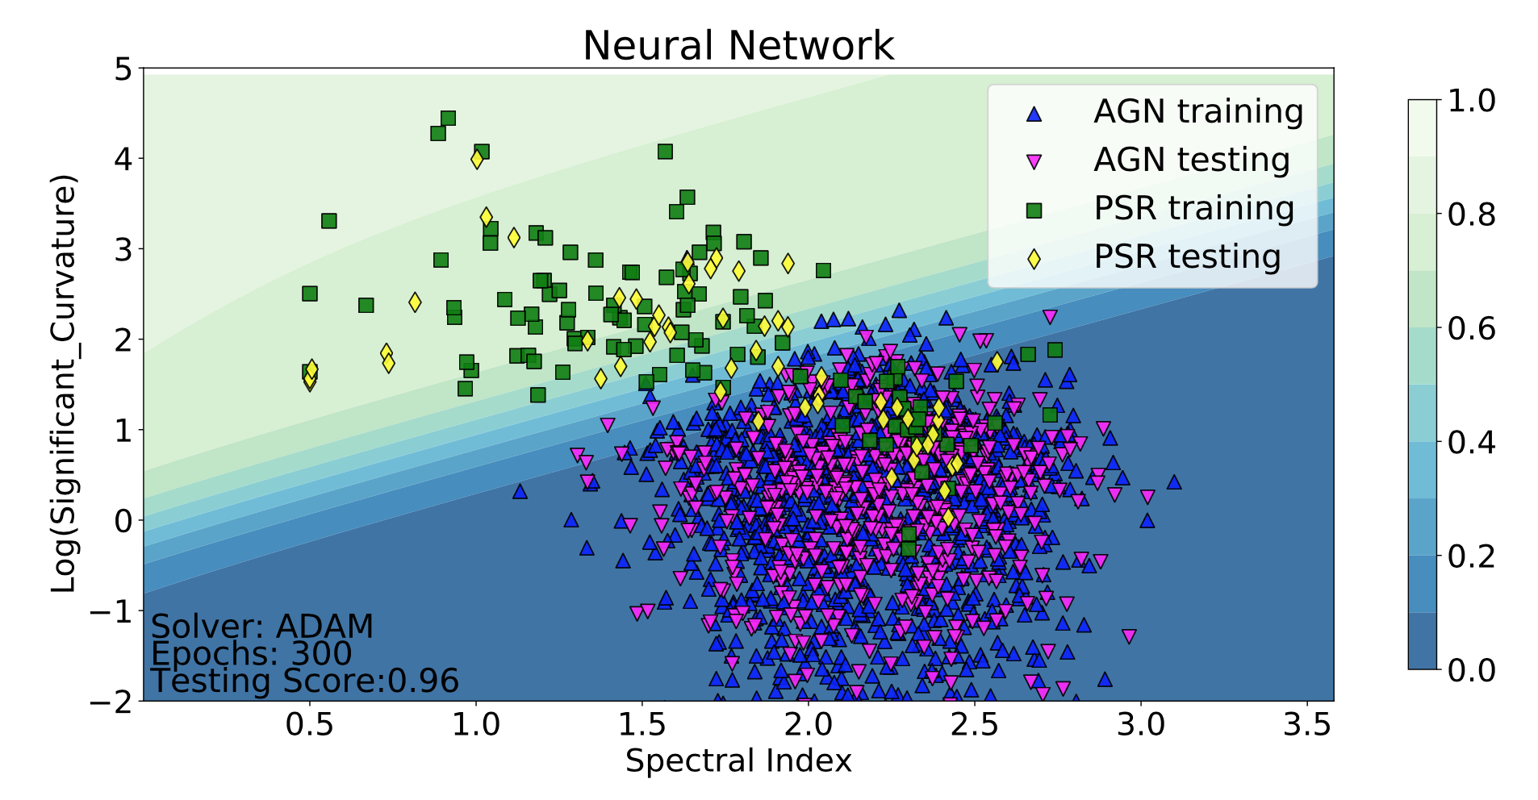
NN domains
The domains for NN are similar to LR, but the boundary is non-linear

Slide 23
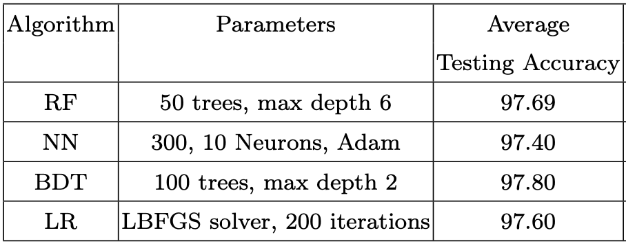
Selected ML algorithms
In the analysis of the unassociated 3FGL sources, we have selected the following algorithms
For the probabilistic catalog, we are not going to choose “the best” method, but rather report the probabilities obtained with all four methods
The methods have similar test accuracy
Differences among predictions can serve as an estimate of the systematic error.

Slide 24
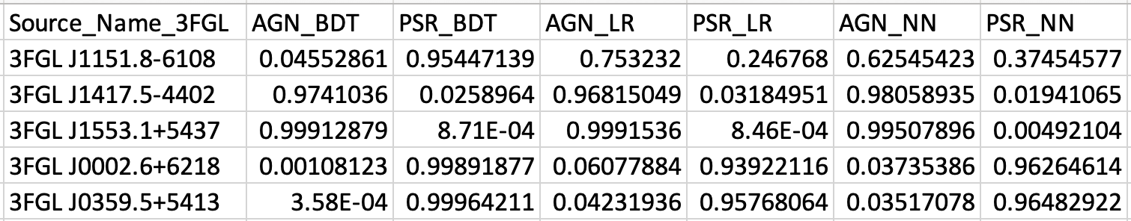
Probabilistic catalog
In particular, the catalog will have columns with probabilities for the source to be an AGN or a PSR in a two-class classification for different algorithms
One can notice that for the first source, that BDT classifies it as an AGN, while LR and NN classify it as a PSR.
What is this source?
There exists now the 4th Fermi LAT catalog 4FGL, where some of the unassociated sources from 3FGL have associations.
We can use the new associations to independently “test” the classifications with the ML methods.

Slide 25
Comparison with 4FGL
In 4FGL catalog, there are 242 sources which were unassociated in 3FGL and have either AGN or PSR associations now
We use these sources to independently test the performance of the ML algorithms
4FGL PSRs
which had mixed classifications by ML algorithms in 3FGL
This is the “mixed” source in the table on the previous slide

Slide 26
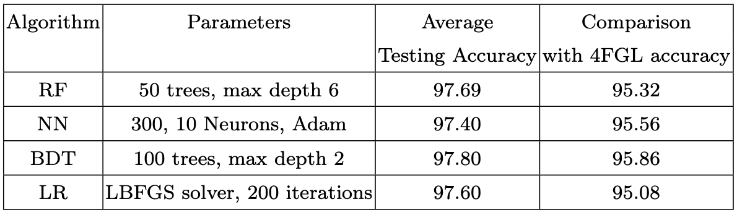
Comparison with 4FGL
Accuracy of prediction of the class of unassociated sources in 3FGL using associations in the 4FGL.
The 4FGL comparison accuracy is only ~ 2% worse than the average testing accuracy based on the 3FGL data.
Out of 14 sources with mixed and wrong associations, 7 have “flags” in 3FGL, e.g., due to high uncertainties in background.
For some sources spectral parameters have changed a lot.

Slide 27
Current / future work
Construction of probabilistic classifications for 4FGL unassociated sources
Search for outliers in associated sources, i.e., sources for which the ML class is different from the association class
Looking for applications of probabilistic catalogs.
For example one can calculate dN/dS distributions (number / flux) including unassociated sources, which typically have smaller flux. This would extend the dN/dS to lower fluxes.

